Slide 1





BUILDING NATIONS EMPOWERING COMMUNITIES

Slide 2

ABOUT JINDAL STEEL AND POWER
Who We Are,
  JSP is an industrial powerhouse with a dominant presence in steel, power, mining and infrastructure sectors. Led by Mr Naveen Jindal, the company’s enviable success story has been scripted essentially by its resolve to innovate, set new standards, enhance capabilities, enrich lives and to ensure that it stays true to its cherished value system.
Our Mission
  Building Nations, Empowering Communities.
Our Vision
  An ever-flourishing company focused on Nation Building, Value Creation and Sustainable Development.
Our Values
  Extreme Ownership
  Better Than Before
  Respect For People
  Sustainability

Slide 3
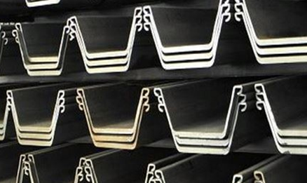
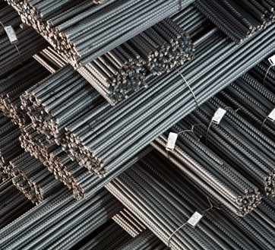
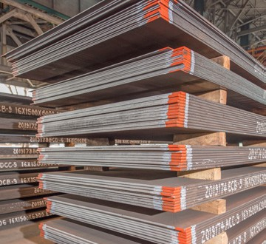
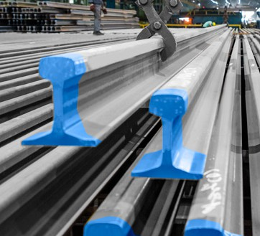
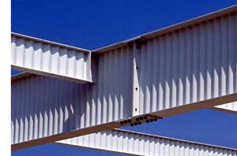
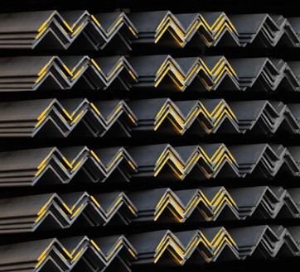
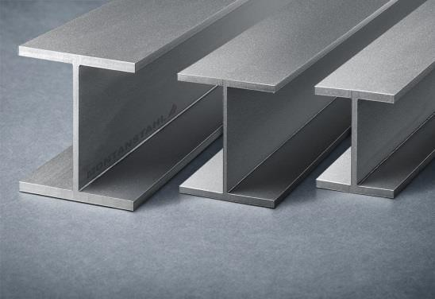
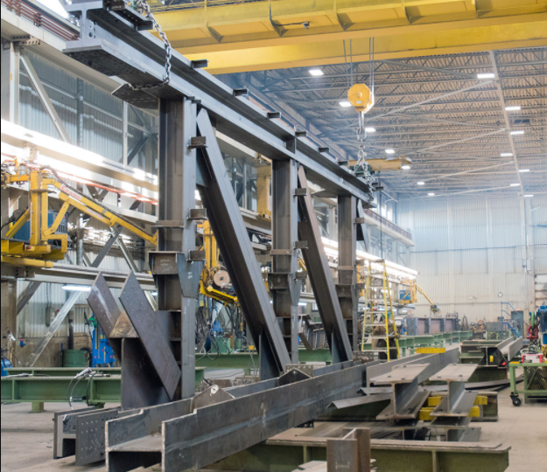
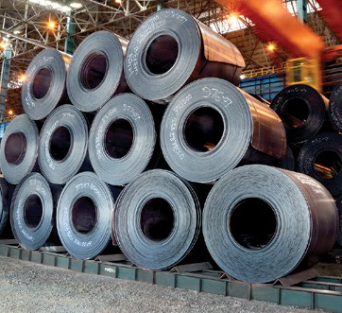
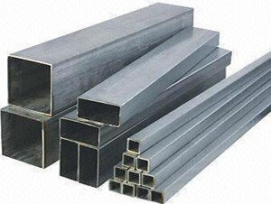
KEY PRODUCTS OF JSP
SHEET PILES
JINDAL PANTHER TMT AND WELDMESH
SINUSOIDAL WEB BEAM
PLATES
RAIL
PARALLEL FLANGE BEAMS AND COLUMNS
FABRICATED BEAMS
HOT ROLLED -COILS
ANGLES & CHANNELS
HOLLOW SECTION

Slide 4

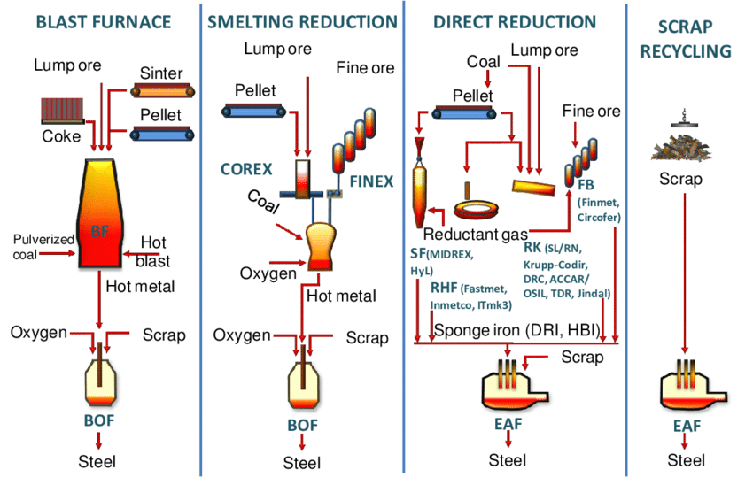
DIFFERENT STEEL PROCESS ROUTE

Slide 5
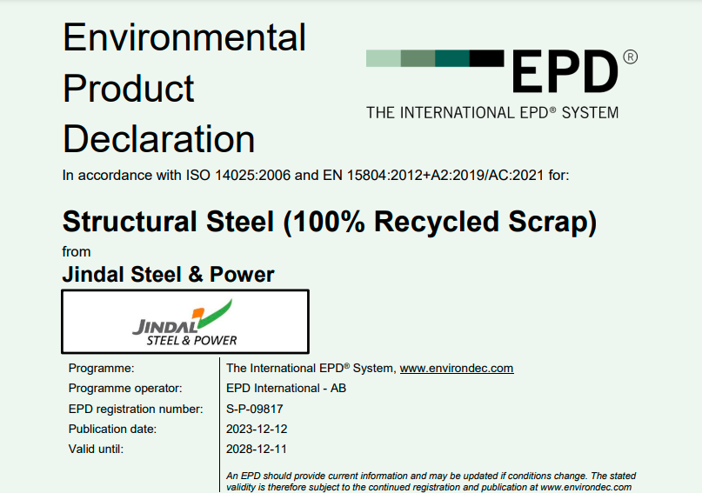
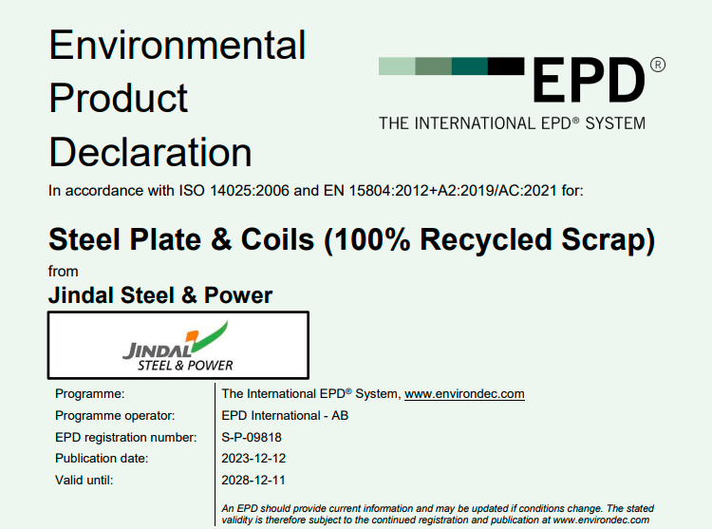


EPD CERTIFICATION: LOW CARBON EMISSION STEEL
Process Route: 100% Recycled Scrap + 88% Renewable Energy + 12% Non-Renewable Energy
C02 Emission per MT of Steel with above route:
Plates: 458 Kg/MT
Structural: 504 Kg/MT

Slide 6
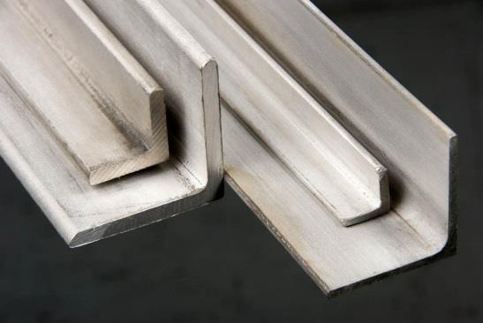
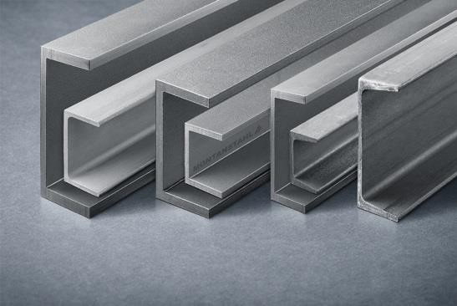
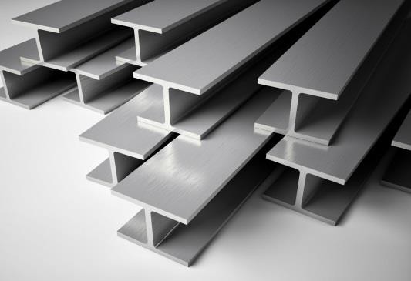
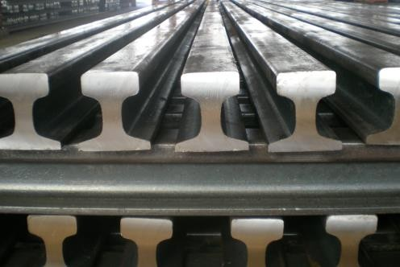
JSP STRUCTURAL PRODUCT RANGE
UB Sections | UB 152 (89/100), UB 178, UB 203 (102/133), UB 254, UB 305 (102/165), UB 356, UB 406 (140/178), UB 457 (152/191), UB 533 (165/210), UB 610 (229/305), UB 762, UB 838
UC Sections | UC 152, UC 203, UC 254, UC 305, UC 356 (368/406)
IPE Sections | IPE 160, IPE 180, IPE 200, IPE 360, IPE 400, IPE 450, IPE 500, IPE 600, IPE 750
HE Sections | HE 160, HE 320, HE 600, HE 700, HE 800, HE 900
W Sections | W 6x4, W 6x6, W 8x4, W 8x5.25, W 8x8, W 10x5.75, W 10x10, W 12x4, W 12x6.5, W 12x12, W 14x6.75, W 14x14.5, W 14x16, W 16x5.5, W 16x7, W 18x6, W 18x7.5, W 21x6.5, W 21x8.25, W 24x9, W 24x12.75, W 30x10.5
NPB Sections | NPB 160, NPB 180, NPB 200, NPB 350, NPB 400, NPB 450, NPB 500, NPB 600, NPB 750
WPB Sections | WPB 150, WPB 160, WPB 200, WPB 320, WPB 600, WPB 700, WPB 800, WPB 900
HD Sections | HD 260, HD 360, HD 400
HP Sections | HP 305, HP 360
Channel Sections | CH 100, CH 125, CH 150, CH 175, CH 200, CH 250, CH 300, CH 400
Angle Sections | AL 75, AL 80, AL 90, AL 100, AL 110, AL 120, AL 125, AL 130, AL 150, AL 180, AL 200, AL 250
Hi-Rise Sections | JNPB 450x160, JNPB 500x180
Ultra Light Section | ULB 12x3x10.8, ULB 12x3x11.8

Slide 7
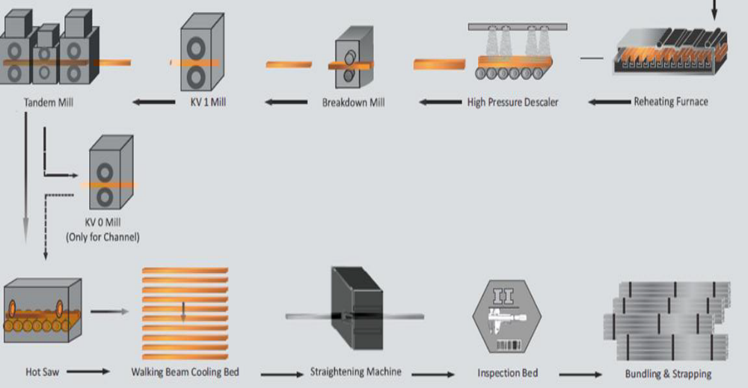
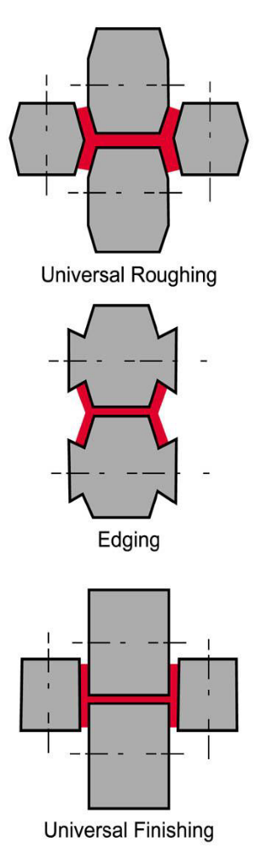
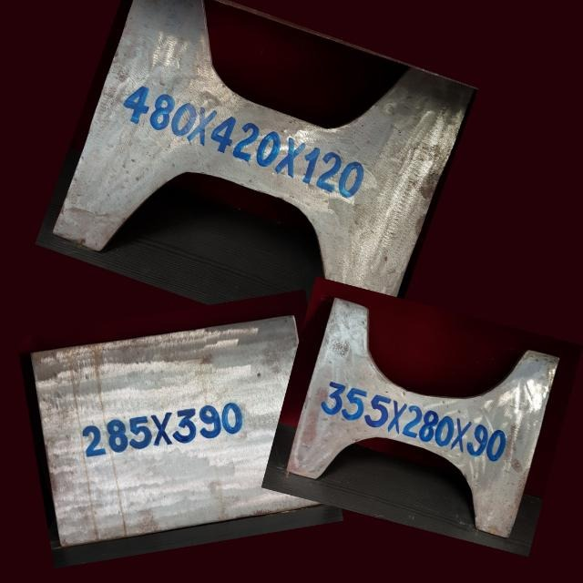
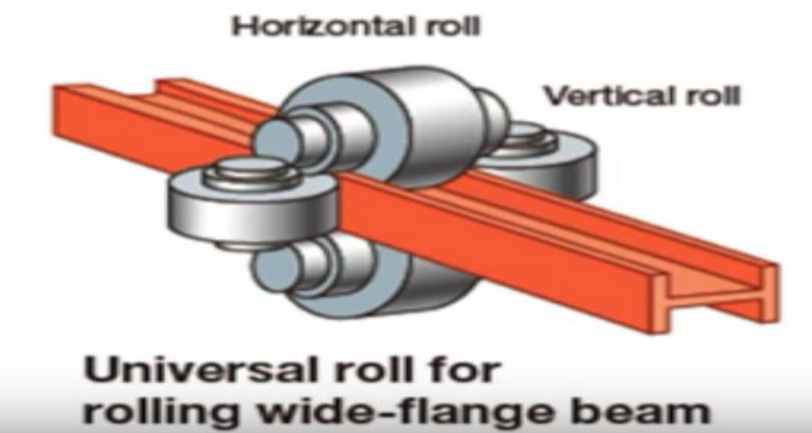
Rolling Process for HR Sections
Rolling Process

Slide 8
ADVANTAGES OF STEEL STRUCTURES
They are super-quick to build at the site, as a lot of work can be pre-fabricated at the factory with skilled labour.
Project can be competed with in shortest possible time frame.
Ease in expansion of the existing steel structure.
Ease in repair & rehabilitation or retrofitting.
They are flexible, which makes them very good at resisting dynamic (changing) forces such as wind or earthquake forces.
A wide range of ready-made structural sections like I, H, C and L is available in wide variety of grades.
They can be made to take any kind of shape.
Steel can be recycled.

Slide 9
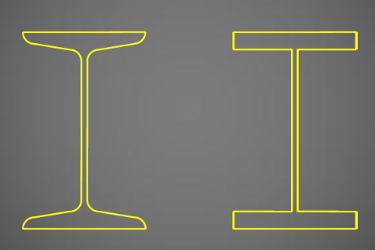
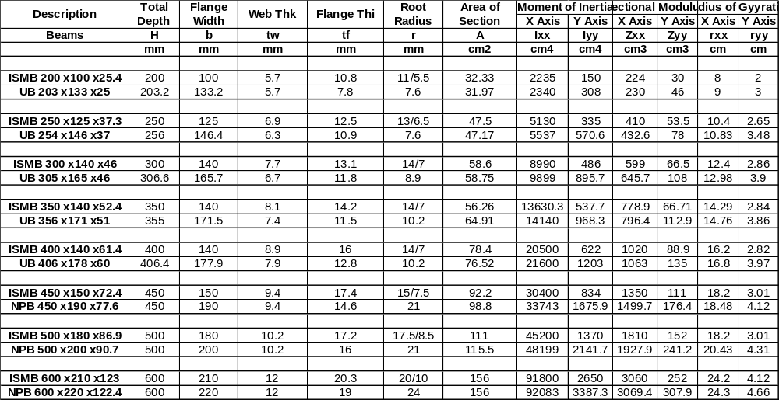
ADVANTAGES OF JSP ROLLED SECTIONS
1. superior Sectional Properties

Slide 10
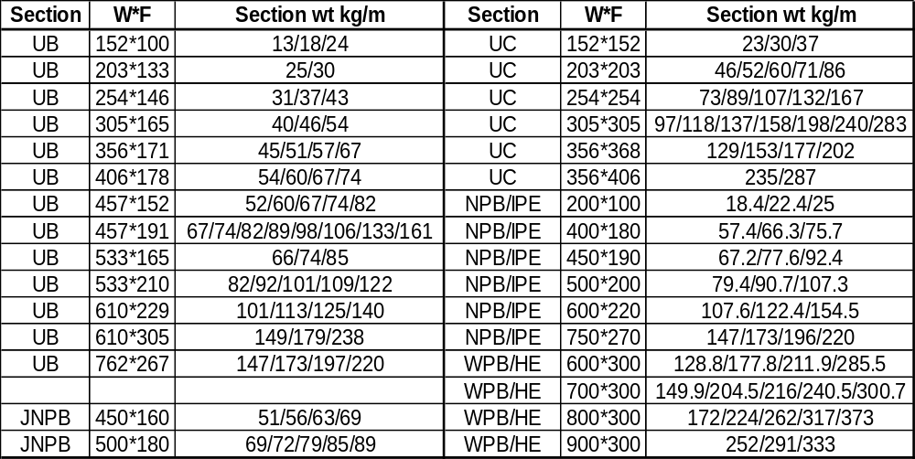
2. wide rangE of sectional weight for same section

Slide 11
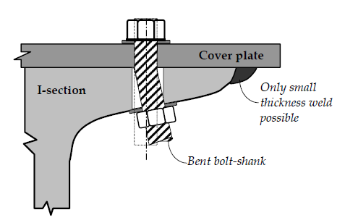
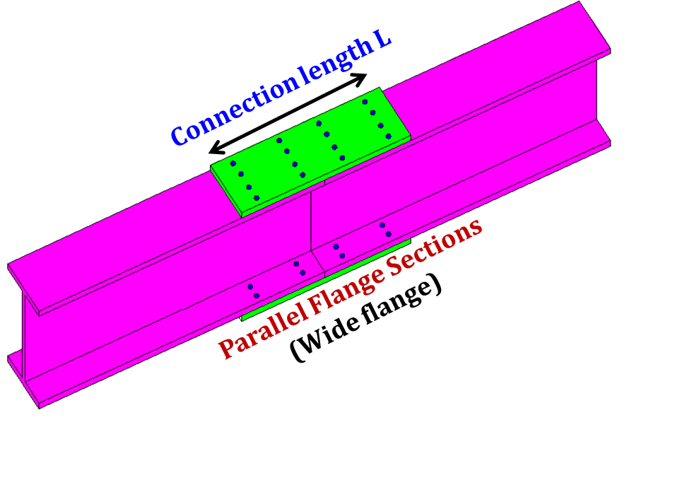
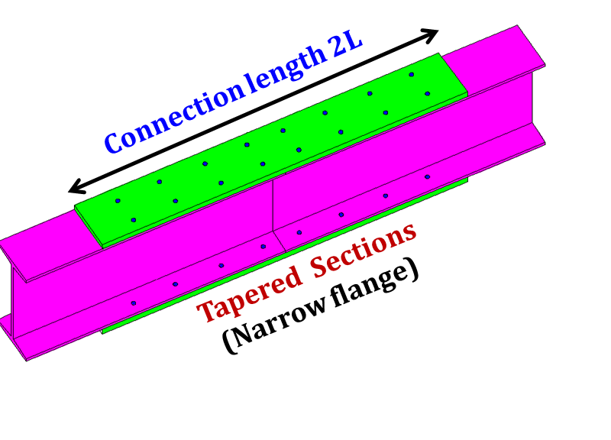
3.CONNECTION & JOINT STRENGTH
Effects of tapered flange:
Bolted connection: Bolt shank gets bent on tightening from the original straight alignment and
Welded connection: Only obtuse angled small thickness weld possible at the tapered tip
Tapered and narrow flange Indian sections result in two times more splice connection length compared to Parallel flange sections .
Tapered and narrow flange Indian sections are prone to zipper effect.

Slide 12
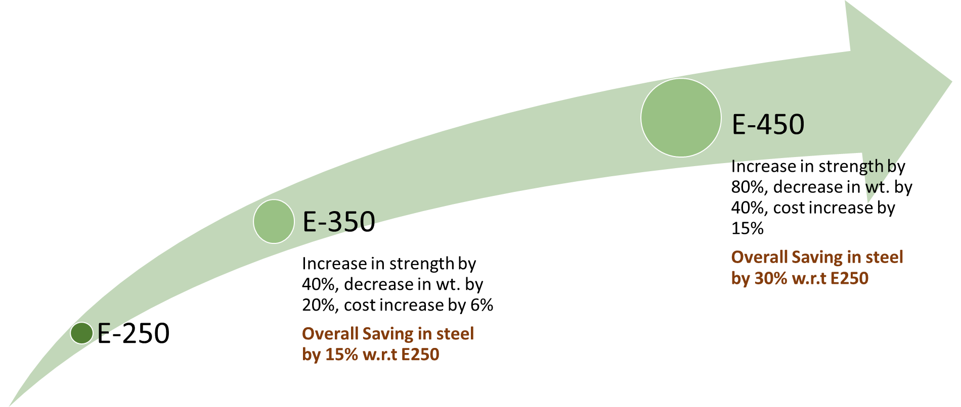

4. SAVING IN STEEL USING HIGH STRENGTH STRUCTURAL STEEL
E-410
Increase in strength by 64%, decrease in wt. by 32%, cost increase by 10%
Overall Saving in steel by 25% w.r.t E250

Slide 13
ADVANCTAGES OF JSPL ROLLED STRUCTURES
Advantage 5- Customised length.
JSP can supply material in customised length from 6mtrs to 18 mtrs.
  Avoid wastage due to excess or non uniform length.
  Avoid welding, lapping or joints to increase length/span.
Advantage 6- FASTER AND TIME BOUND DELIVERY.
All sections in all grades are being rolled atleast once in a month.
Smaller campaign size assures faster delivery.
Advantage 7- Others
Straightness/ camber is well with in the tolerance limit.
Well controlled dimensional tolerance. Clean and clear surface finish.
YS/UST/% El well above minimum required. ( Rich chemistry steel).
Supply can be controlled on number of piece basis to avoid storage at critical stage.
No issue of MOQ.

Slide 14
JSPL ROLLED STRUCTURES VALUE PROPOSITION
Superior and advance product.
Options – Optimisation
Cutomised length – Less wastage
On time and assured delivery – On time executions and completion
OVER ALL COST SAVING -ABOUT 20 TO 25 %
High strength – Less Weight

Slide 15
JSP FIRE RESISTANT STEEL
Produced as per IS15103
Rated to withstand temperatures up-to 600 degrees Celsius for a maximum duration of 3hrs.
Possess fine crystal structure (reduced Sulphur content).
Micro alloys like Cr, Mo, V, Nb etc. adds to the formability and enhanced mechanical properties.
Carbon Equivalent is well controlled, hence offer good Weld-ability.
Available in all sections/profiles being manufactured by JSP
FIRE RESISTANT STEEL WELDING
Grade | Electrode used
E250 | E 7018
E350 | E7108 & E8018
Fire Protection via external medium | JSP Fire Resistant Steel
Its base material + external application. | Base material does the job.
Increase of dead weight/load of a structure. | Structure is at optimum weight.
Additional work/ time for design, selection and application. | No such requirement.
Frequent maintenance of external protection. | No such requirement.
Skill labor at site plays major role in end result. | No such limitation.
Limitation on shape/size, aesthetic, complexity. | No such limitation.
Polluting and Hazardous - Glass Wool, Fumes. | No such limitation.
Cost increase exponentially with higher fire rating and variables. | Cost is more stable.

Slide 16
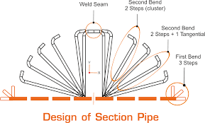
JSP HOLLOW SECTION
JSP hollow sections are manufacture through, Direct Forming Technology (DFT).
Advantages of Direct Forming Technology (DFT).
  Precise dimensional tolerance with assured corner radius control.
  Uniformity of dimensions across the length and lot.
  Superior surface finish.
  Higher customization and flexibility.
  Shorter lead time
SQUARE HOLLOW SECTION (SHS)
  Size range in mm-150 X 150 to 600 X 600, Thickness -4mm to 22mm
RECTANGULAR HOLLOW SECTION(RHS)
  Size range in mm – Mill 1 100 X 200 to 150 X 450, Mill 2 - 300 X 350 to 400 X 600, Thickness -4mm to 22mm
Strength Grade – Ys 250 to 550 MPA.
Capacity – 0.6 MTPA.

Slide 17
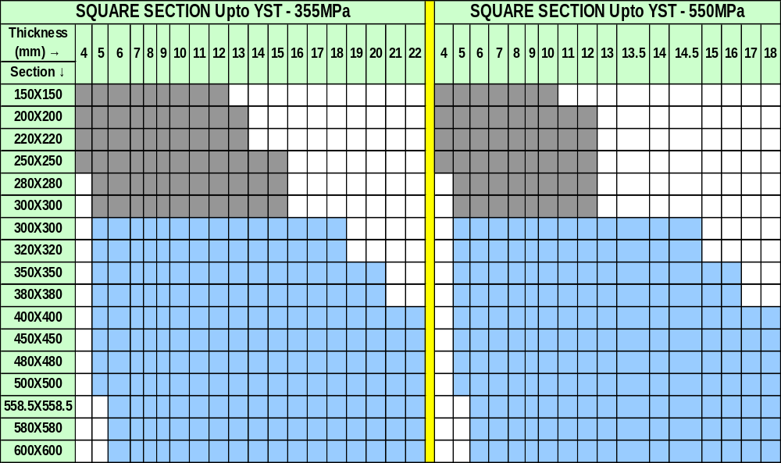
JSP SQUARE HOLLOW SECTION PRODUCT RANGE

Slide 18
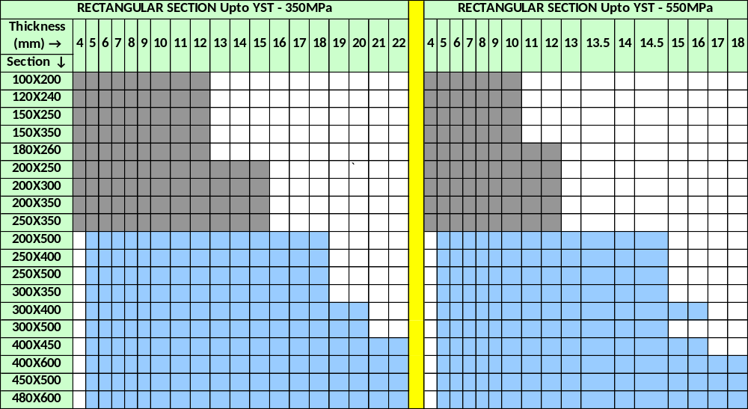
JSP RECTANGULAR HOLLOW SECTION PRODUCT RANGE

Slide 19

CORRUGATED(SINUSOIDAL) BEAMS FROM JSP
JSP has recently installed Corrugated (Sinusoidal) Web Beam technology – at Angul Plant
The Corrugated Web Beams Comprise of wide plate flanges welded to a corrugated web.
Corrugated Beams enhance efficiency, performance, and durability of the structural members.
Advantages and Characteristics of Corrugated Beam:
                1. Weight reduction.
                2. Significant cost savings.
                3. Reduced roof dead loads
                4. Prevention of web buckling failure through corrugation
                6. Versatile architectural capabilities
                7. Variable height beams for optimal utilization of sinusoidal beam strength
This cutting-edge technology offers a multitude of benefits to Pre-engineered buildings / Industrial Sheds/warehouses and are available in following range.
Web Thickness (in mm) | 1.5 – 6 mm
Web Height (in mm) | 333/500/625/750/1000/1250/1500mm
Beam Length (in metres) | 4 – 16 metres
Flange Width (in mm) | 120 – 450 mm
Flange Thickness (in mm) | 6 – 30 mm
Savings wrt welded I-Beam | 10-30%

Slide 20
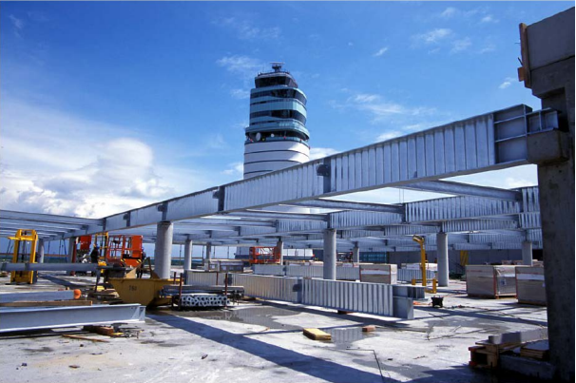
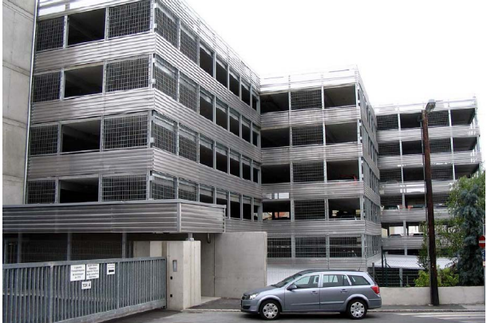
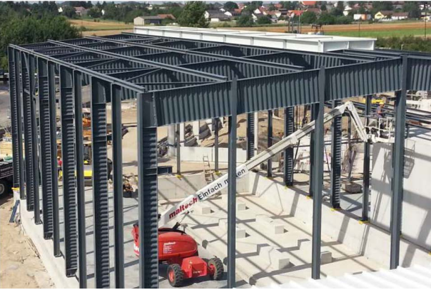
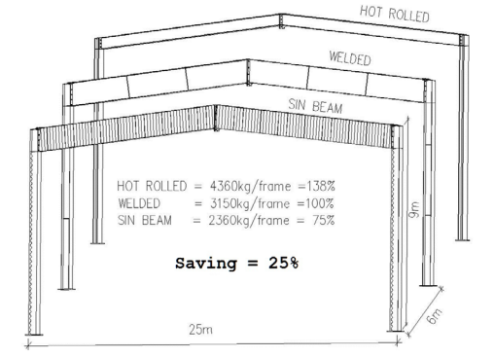
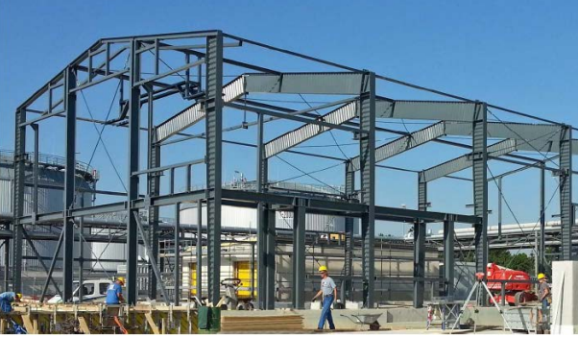
APPLICATIONS OF CORRUGATED BEAMS

Slide 21

THANK YOU

